Slide 1
COMP 1800
Week 7 - Wednesday

Slide 2
Last time
What did we talk about last time?
while examples
List comprehensions
Reading data from the Internet

Slide 3
Questions?

Slide 4
Assignment 5

Slide 5
Color

Slide 6
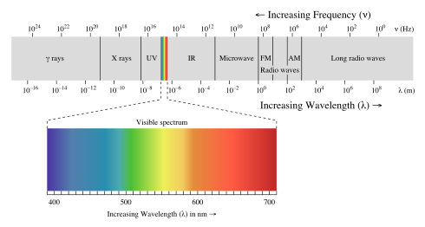
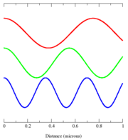
Light
Visible light is a form of electromagnetic radiation
We could think of it as a wave with a specific frequency
Instead, color theorists have discovered that we can represent most visible colors as a combination of a small number of set colors

Slide 7
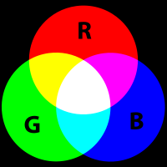
RGB
One system for representing color is RGB
With Red, Green, and Blue components, you can combine them to make most visible colors
Combining colors is an additive process:
With no colors, the background is black
Adding colors never makes a darker color
Pure Red added to pure Green added to pure Blue makes White
RGB is a good model for computer screens

Slide 8
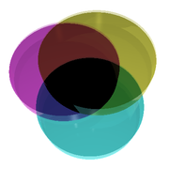
CMYK
CMYK stands for Cyan, Magenta, Yellow, and Key (Black)
CMYK is another color system, but it’s a subtractive system
With no colors, the background is white
Adding colors never makes a lighter color
Pure Cyan added to pure Magenta added to pure Yellow makes Black
CMYK is useful for printing, not for computer screens

Slide 9
Installing necessary libraries
The image manipulation we want to do with Python requires libraries to be installed
Open the command line appropriate for your OS and type:
The > isn't something you type, it's just a way to show it's on the command line
On your own machine, you will only need to do this once
On lab computers, you might have to do it every time you log in
> pip install pillow
> pip install cImage
>

Slide 10
Differences from the book
The newest version of cImage (installed from the command line) uses the namespace image instead of cImage
Everywhere the book says cImage, say image instead
There are a few other small differences, notably the title of the window
Book version:
Our version:
from cImage import *
window = ImageWin('Window Name', 800, 600)
from image import *
window = ImageWin(800, 600, 'Window Name')

Slide 11
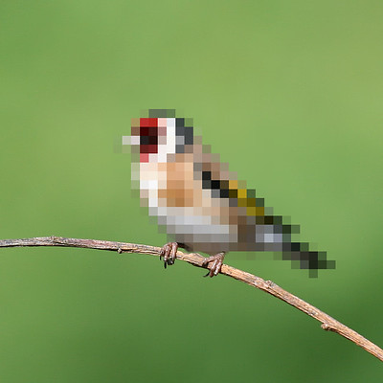
Pixels
All computer images are made up of pixels
Short for picture elements
Each pixel is a single color
The smaller the pixels, the more realistic the image
Image by Rego Korosi
https://www.flickr.com/photos/korosirego/4592913123/

Slide 12
Pixel class
The Pixel class is a way for Python to keep track of colors, using an RGB model
This class is one of many we will be using from the image module
To use this library, you need to type:
from image import *
Each Pixel object represents one of 16,777,216 different colors with a value between 0-255 for Red, Green, and Blue

Slide 13
Example colors
Color | Red | Green | Blue
Black | 0 | 0 | 0
Red | 255 | 0 | 0
Green | 0 | 255 | 0
Blue | 0 | 0 | 255
Orange | 255 | 165 | 0
Gray | 128 | 128 | 128
Cyan | 0 | 255 | 255
Magenta | 255 | 0 | 255
Yellow | 255 | 255 | 0
White | 255 | 255 | 255

Slide 14
To use Pixel
To create a custom color:
Create colors using Pixel to specify RGB values
Get individual values using:
getRed()
getGreen()
getBlue()
color = Pixel(255,165,0) # orange
green = color.getGreen()

Slide 15
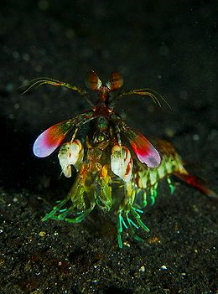
Luminance
If the R, G, B values happen to be the same, the color is a shade of gray
255, 255, 255 = White
128, 128, 128 = Gray
0, 0, 0 = Black
To convert a color to a shade of gray, use the following formula:
value = .3R + .59G + .11B
Then, the color will be (value, value, value)
Based on the way the human eye perceives colors as light intensities

Slide 16
Image Class

Slide 17
Purpose of the Image class
Because images have complex file types, some educators wrote the Image class
It's a simple interface for doing routine things with an image
Loading/saving an image
Getting the height and width of an image
Changing the pixels of an image
Drawing the image

Slide 18
Image methods
Method | Use
FileImage(file) | Creates an Image object from a file name
EmptyImage(width, height) | Creates a blank Image of size width by height
getWidth() | Return the width of the image
getHeight() | Return the height of the image
getPixel(x, y) | Return the Pixel which is the color at (x,y)
setPixel(x, y, pixel) | Set the Pixel object at (x,y) to pixel
save(file) | Save the Image to the file with the given file name

Slide 19
Drawing an Image
To see an image, we have to make a window and then draw the image on it
We make a window with following constructor:
ImageWin(width, height, title)
The title variable is a string giving the name of the window
The width and height variables are integers giving the width and the height of the new window in pixels
This is the one where the title is in a different place than the book example

Slide 20
Drawing an Image example
The following creates an Image object from a file called picture.jpg
Then, we create an ImageWin window object to display it
The Image object draws itself on the window
To make the window easier to work with, we call its exitOnClick() method so that it closes when we click on it
picture = FileImage('picture.jpg')
window = ImageWin(picture.getWidth(),picture.getHeight(), 'Picture')
picture.draw(window)
window.exitOnClick()

Slide 21
Nested loops
We can put loops inside of other loops
Doing so is useful when we want to perform a repeated task as part of another repeated task
Example:
Loop over every column in an image
For each column, loop over every row
Code:
for x in range(picture.getWidth()):
for y in range(picture.getHeight()):
# do something

Slide 22
Photo negative
We can make the negative of a photo
Algorithm:
Loop over every column of the image
Loop over every row of the column
Make a new pixel whose red, green, and blue are 255 – red, 255 - green, and 255 – blue
Put the pixel into the image in the same location

Slide 23
Photo negative code
Here's the code for the algorithm from the previous slide
for x in range(picture.getWidth()):
for y in range(picture.getHeight()):
pixel = picture.getPixel(x, y)
red = 255 - pixel.getRed()
green = 255 - pixel.getGreen()
blue = 255 - pixel.getBlue()
picture.setPixel(x, y, Pixel(red, green, blue))

Slide 24
Horizontal mirror
We could make a mirror image of an image, flipping the left and right sides
Like how you look in a Zoom call … or a mirror
Moving from left to right in the original image, copy each column, storing each column from right to left in the new image

Slide 25
Horizontal mirror example
Original
Mirrored
 | 0 | 1 | 2
0 | A
1 | B
2 | C
3 | D
 | 0 | 1 | 2
0 |  |  | A
1 |  |  | B
2 |  |  | C
3 |  |  | D

Slide 26
Horizontal mirror in code
What would the code for mirroring look like?
# the picture to be mirrored
picture = FileImage(file)
mirrored = EmptyImage(picture.getWidth(),picture.getHeight() )
for x in range(picture.getWidth()):
for y in range(picture.getHeight()):
mirrored.setPixel(picture.getWidth() - x - 1, y, picture.getPixel(x, y))

Slide 27
Quiz

Slide 28
Upcoming

Slide 29
Next time…
Namespaces
Work time for Assignment 5

Slide 30
Reminders
Read section 6.4
Finish Assignment 5
Due Friday before midnight!

